Slide 1



Madhav Ecommerce Store
Madhav Ecommerce Store is a thriving online retail business offering a diverse range of products, from clothing and electronics to furniture. With a focus on customer satisfaction and data-driven insights, the store has established itself as a leading player in the industry.
By Amit Ghosh

Slide 2

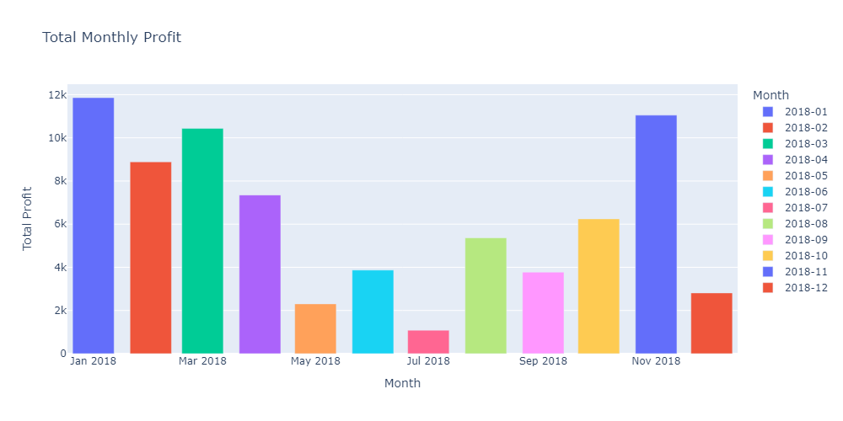
Profitable Months
1
January 2018
Total Profit: ₹11.86k
2
November 2018
Total Profit: ₹11.048k
3
March 2019
Total Profit: ₹10.434k

Slide 3
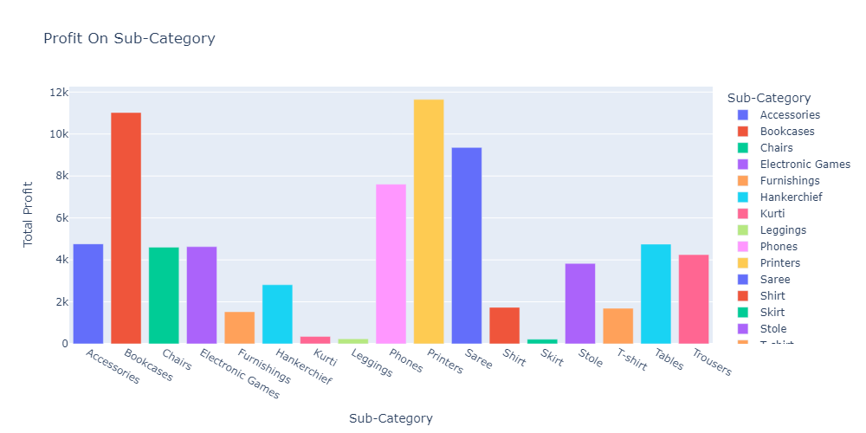
Top 3 Sub-categories
Bookcases
Total Profit: ₹11.024k
Printers
Total Profit: ₹11.648k
Saree
Total Profit: ₹9.358k

Slide 4
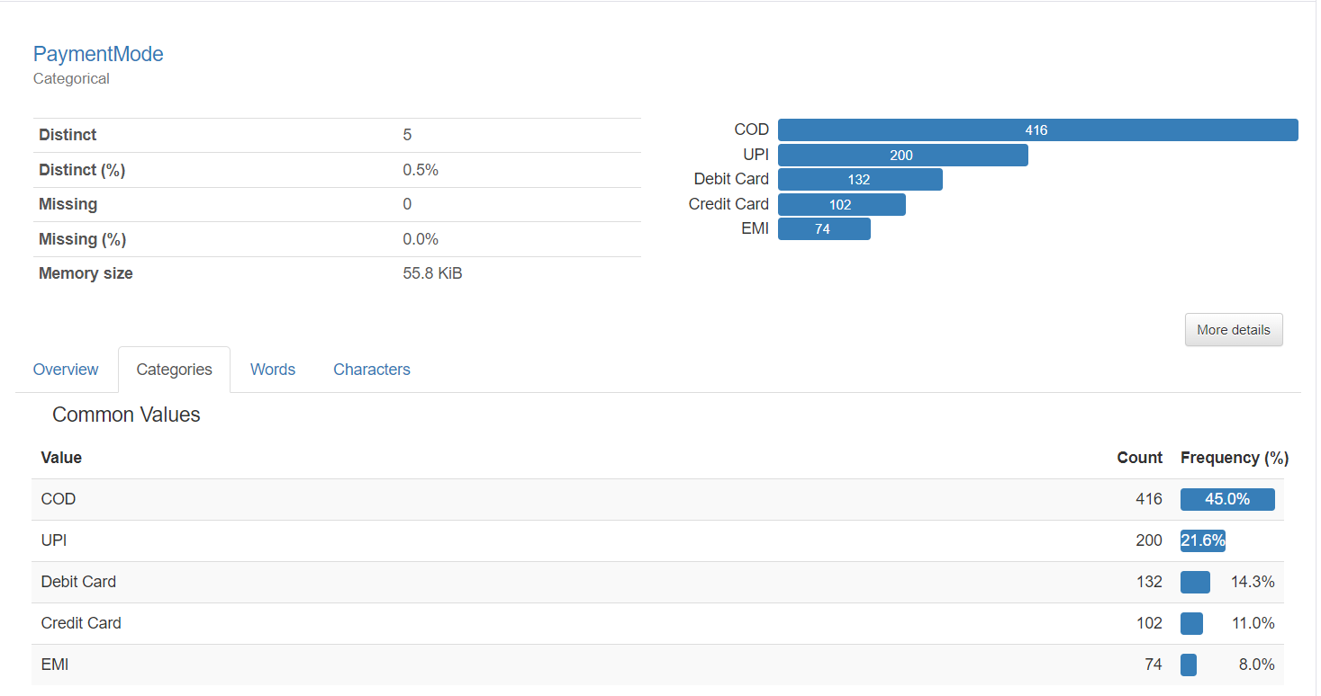
Most popular
Payment mode
Cash on delivery (COD)
Total Value: 45%
Unified payment interface (UPI)
Total Value: 21%
Debit Card
Total value: 14%

Slide 5

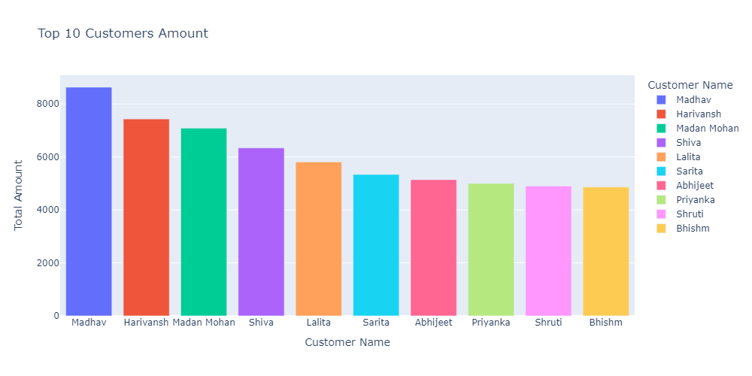
Top Customers
Madhab
Total Amount: ₹8,632
Harivansh
Total Amount: ₹7,434
Madan Mohan
Total Amount: ₹7,082
Shiva
Total Amount: ₹6,339

Slide 6
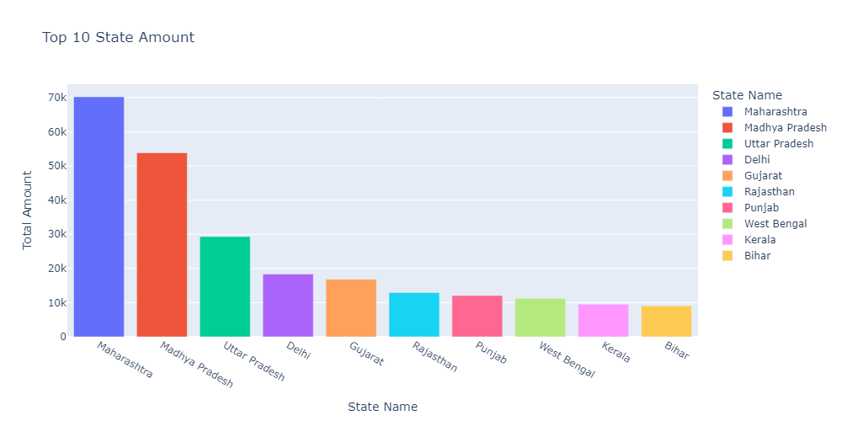
Top States by Spend
Maharashtra
Total Amount: ₹70.24k
Madhya Pradesh
Total Amount: ₹53.847k
Uttar Pradesh
Total Amount: ₹29.345k

Slide 7

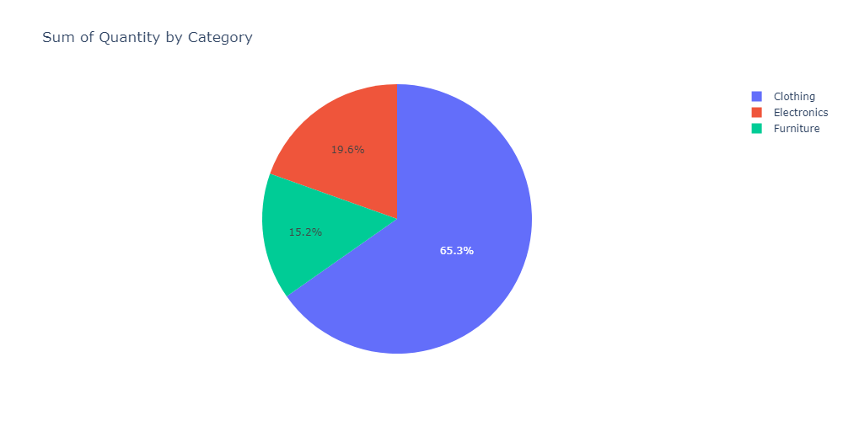
Total Quantity by Category
1
Clothing
Total Quantity: 2,263 (65.3%)
2
Electronics
Total Quantity: 678 (19.6%)
3
Furniture
Total Quantity: 527 (15.2%)

Slide 8


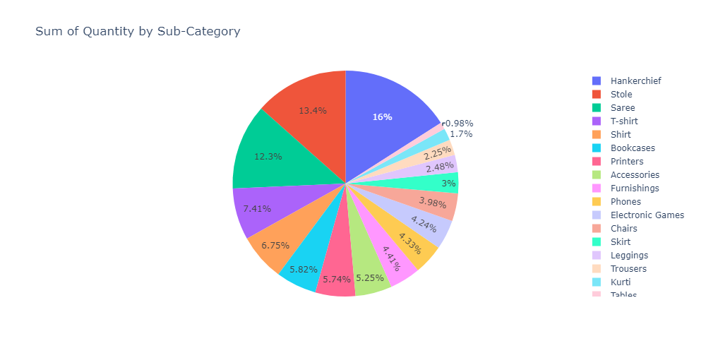


Top Sub-categories by Quantity
Handkerchief
Total Quantity: 554 (16%)
Stole
Total Quantity: 466 (13.4%)
Saree
Total Quantity: 425 (12.3%)

